Slide 1
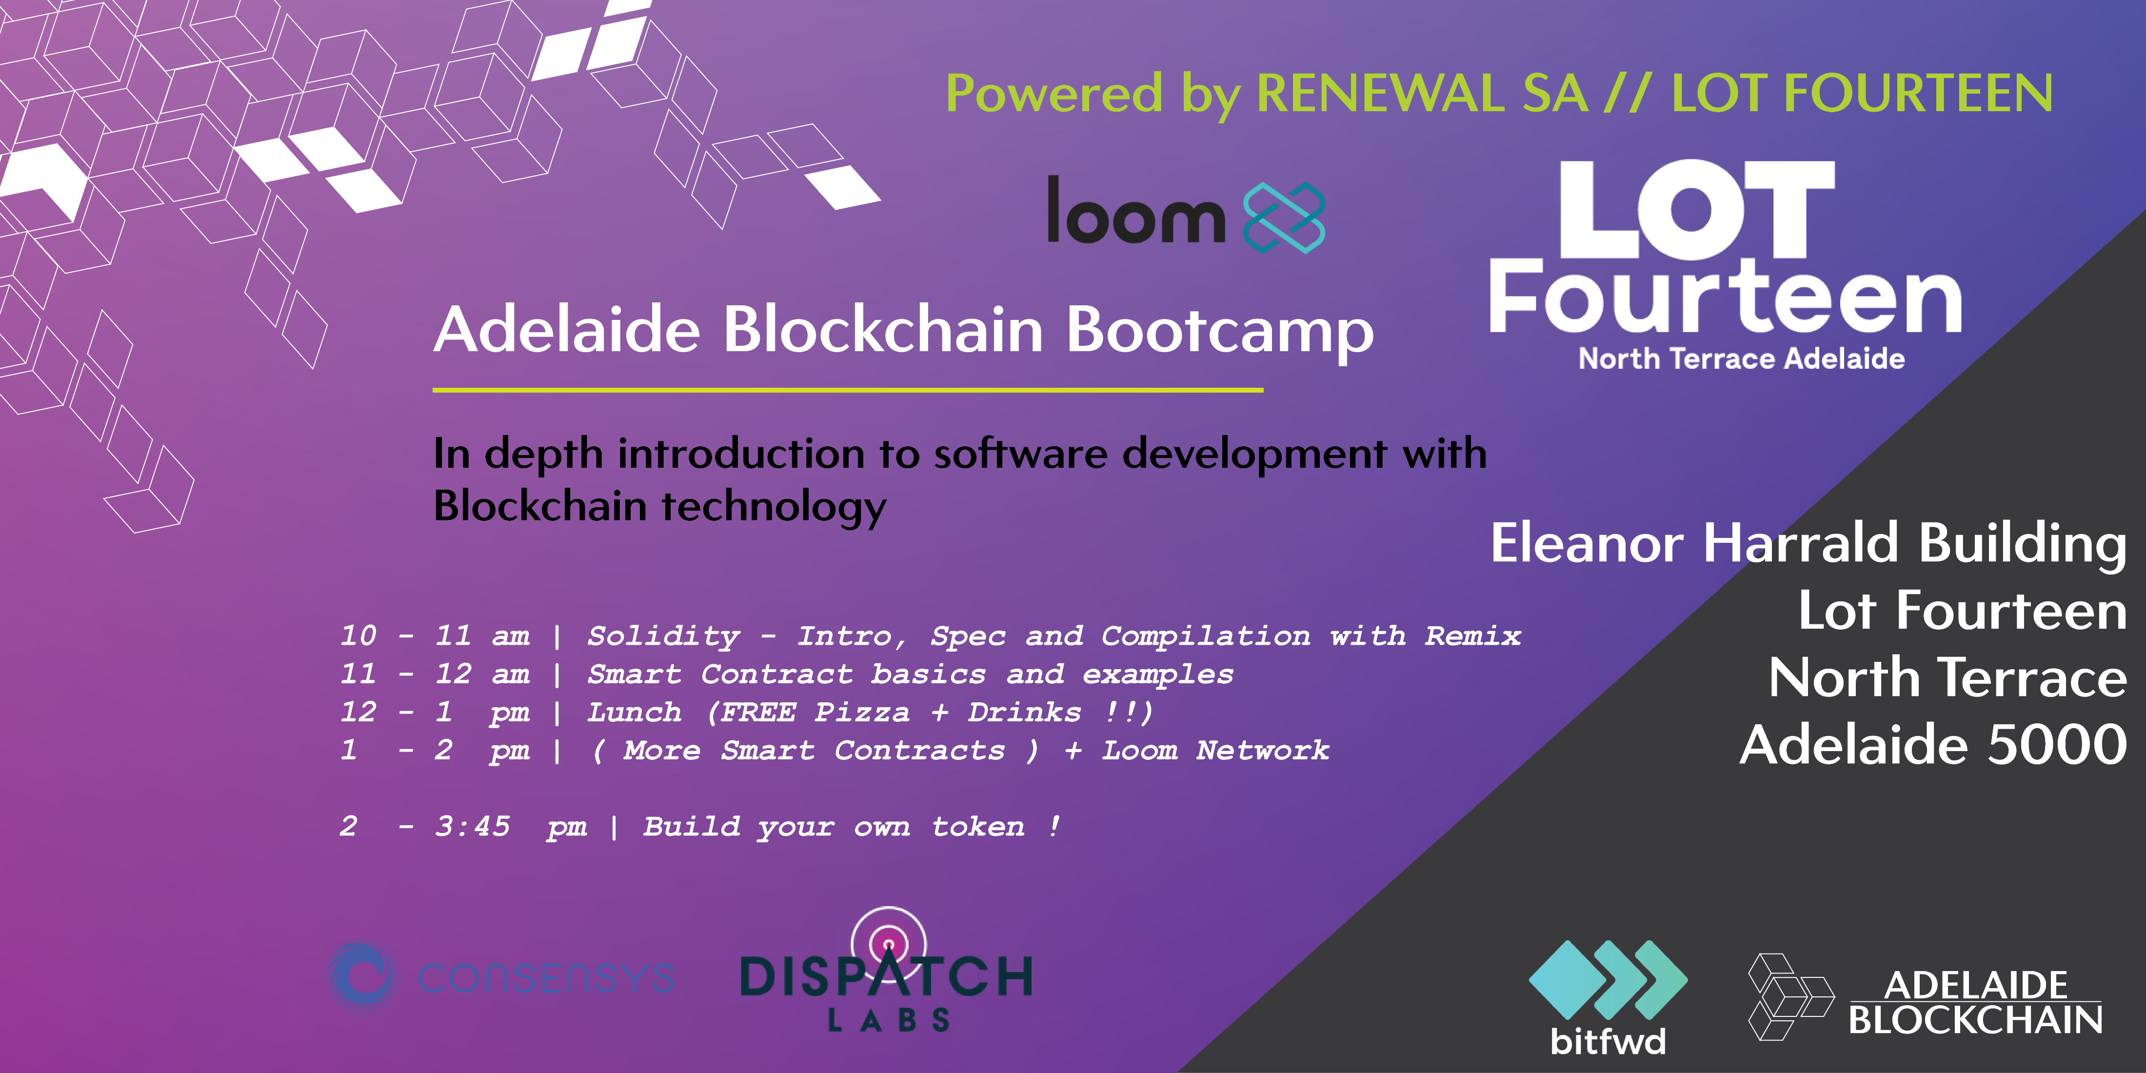
Lecture 01/04
1

Slide 2
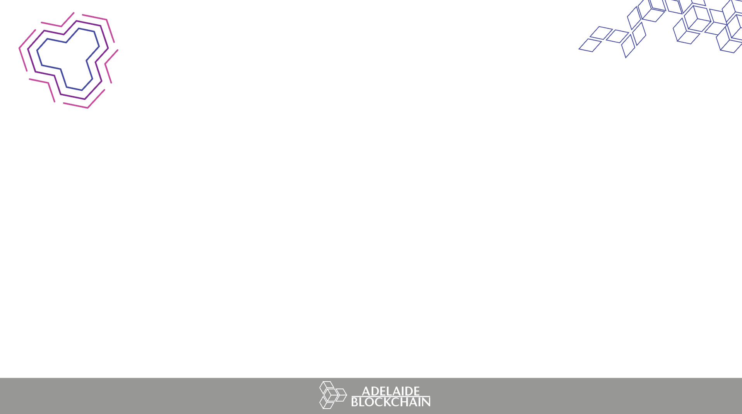


Blockchain primitives
Solidity Deep Dive
Workshop Examples
Building a token
1
2

Slide 3
CENTRAL POINT OF FAILURE
what could go wrong?
System failure
Rent seeking/high fees
Time cost
Human variability
Bank runs
Frozen assets
Seized assets
Fraud
Identity Theft
Hacking
Privacy breaches
3

Slide 4
INTEMEDIATION PROBLEMS
worldwide issues
1. Identity is required to create a bank account
Born in 3rd world country?
No birth certificate?
Cost to create an account?
Access to branch?
2. Currency inflation
Corrupt governments
Weak/unstable/vertical dependant economies?
Bad monetary Policy
Venezuela, Zimbabwe, Turkey
4

Slide 5

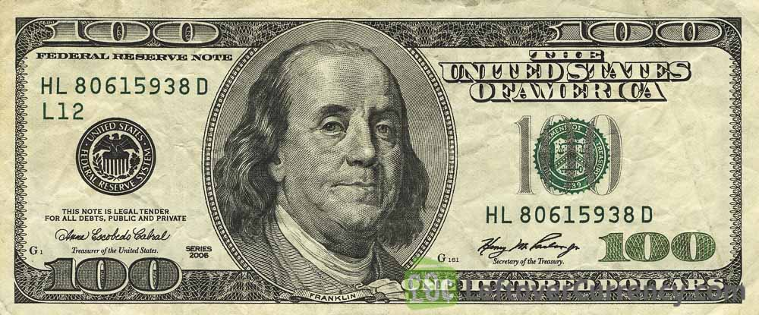
MONETARY SYSTEMS
FIAT CURRENCIES
BUT, bitcoin value is derived by the CODED money supply
Block reward, 12.5 btc
Consensus determines monetary policy!
=
?
Well … no!
USD is legal tender, backed by the USD government
Backed by no asset!
Monetary policy of US government and public sentiment critical!
5

Slide 6
DECENTRALISED SOLUTION
how?
How do you replace a centralized authority?
How do you ensure sound money (no double spends)?
How do you get equal players to all reach consensus on a state of truth in distributed systems?
BYZANTINE GENERALS PROBLEM
We will get back to this …..
5

Slide 7
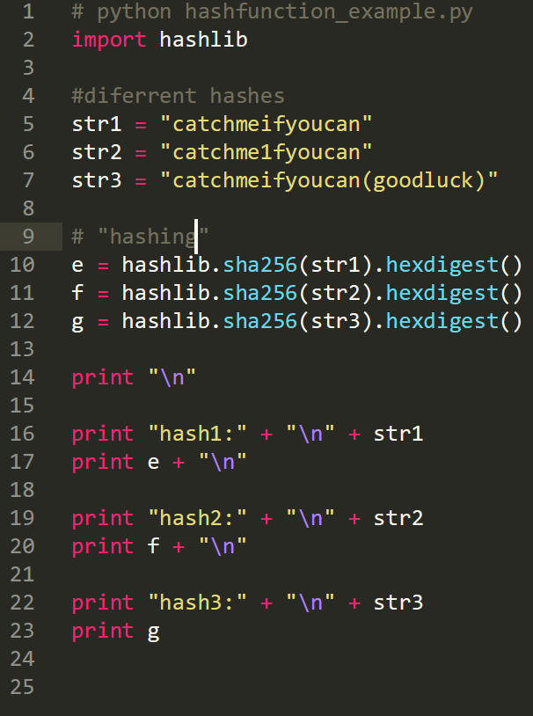
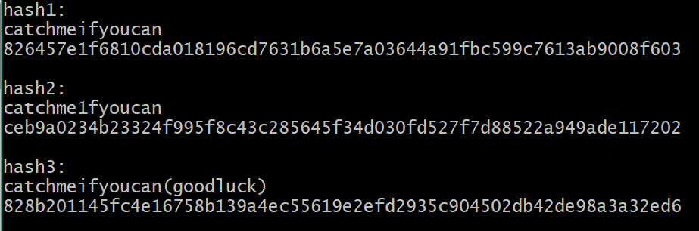
CRYPTOGRAPHIC PRIMITIVES
hash functions
MD5, SHA1, SHA2 etc
One small change in the input completely changes the output
6

Slide 8



CRYPTOGRAPHIC PRIMITIVES
public/private key cryptography
Public/private key cryptography allows for transfer of encrypted data without needing to first have sender/receiver chose a shared private key.
PRIVATE KEY
PUBLIC KEY
BITCOIN ADDRESS
PubAddr = RIPEMD160(SHA256(PubKey))
Pubkey = k x G
Base58 Encoding
Elliptic Curve Multiplication
Hashing
7

Slide 9
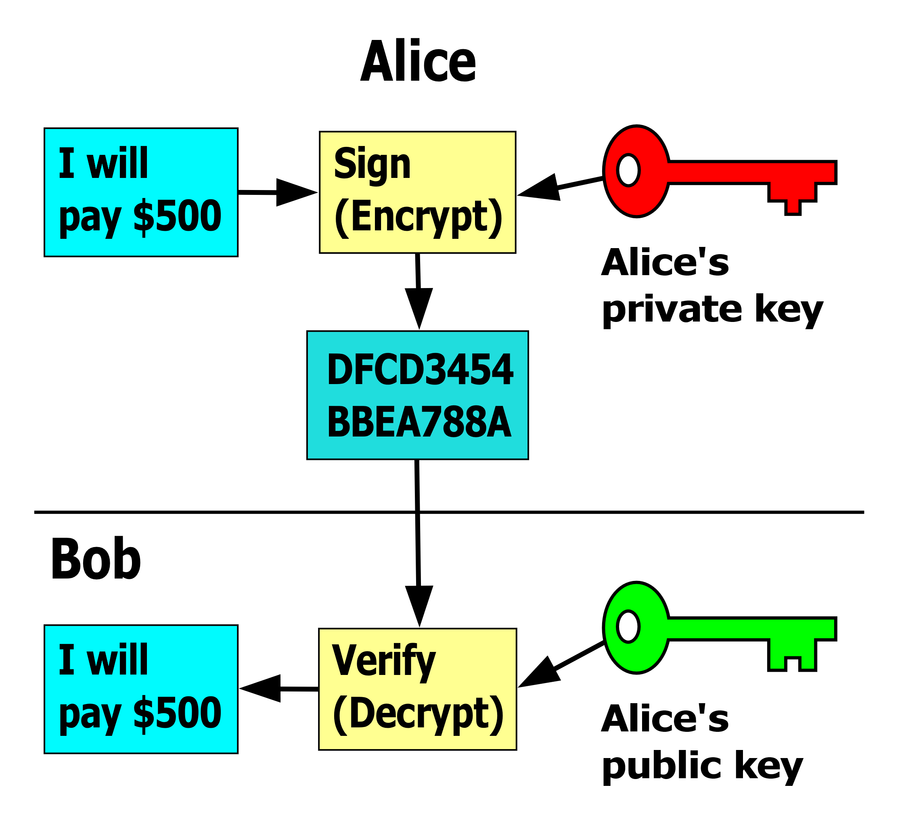
CRYPTOGRAPHIC PRIMITIVES
cryptography types
TYPES
Symmetric cryptography
Common key between sender/receiver
How to keep key inaccessible (physical limitations)?
Assymetric: Public/private key cryptography
Sender and receiver has different private keys
Public and Private keys necessarily related
Private key indecipherable from public key
Digital Signatures!
8

Slide 10
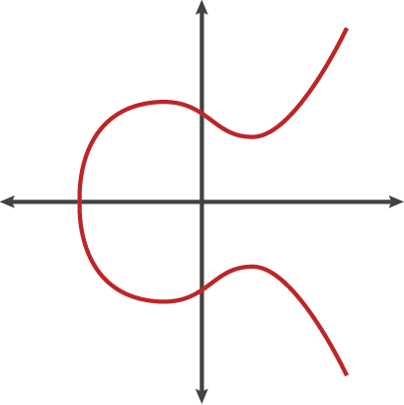
CRYPTOGRAPHIC PRIMITIVES
Digital Signatures
Digital analogue to an ordinary signature; signing off on transaction data
They prove the ownership of a private key, without revealing it!
Digital Signature properties
Authorization: Only the owner of the private key can create a signature that is correctly verifiable with the associated public key
Nonrepudiation: Once signed, the signature is undeniable.
Immutable: Once the signature is signed, is cannot be changed.
You only need the transaction data and the associated public key to verify a
Transaction!
The receiver must produce a signature with the transaction data and their private key to receive the bitcoin!
9

Slide 11
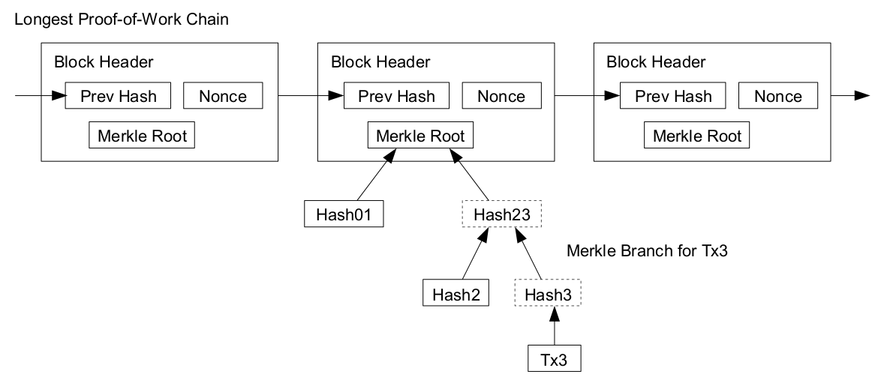
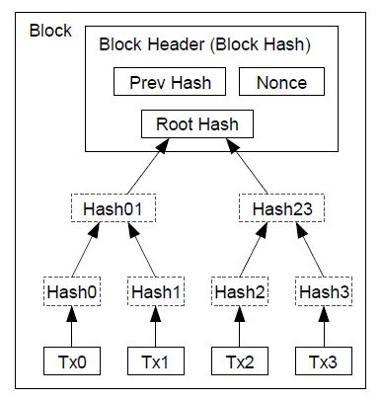
THE CRYTOGRAPHIC PUZZLE
Forming the header
YES!! The Blockchain is really just a linkedlist!
10

Slide 12
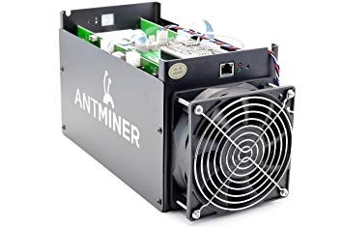
PROOF OF WORK
Security
Satoshi’s initial vision was “1 CPU = 1 vote”.
If you use computational power, you have the chance of solving the cryptographic puzzle first.
By having a permissionless Blockchain, anyone with computational power can vote, creating a directly decentralised system of governance, amazing right!
In reality, the rise of ASICs, pools and leverage of economies of scale makes it infeasible for the average person to mine → Centralising power?
11

Slide 13
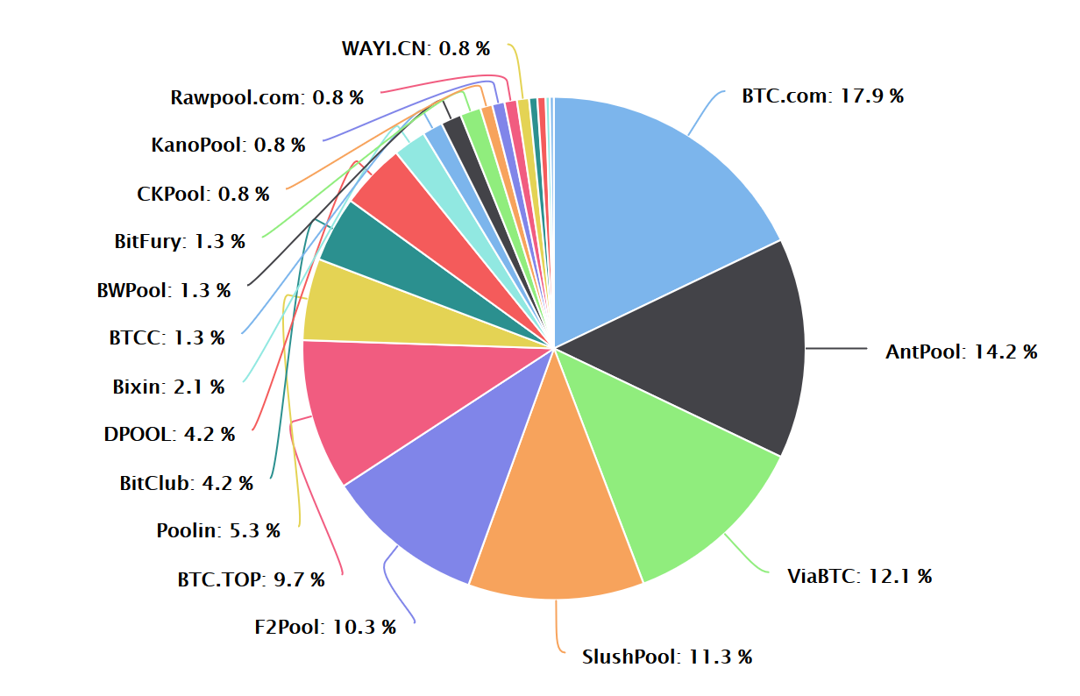
Proof of Work
Pooling
81% of all Pools are Chinese
71% of all hashpower comes from China
Why?
China has some of the cheapest power in the World.
Close access to cheap and quality hardware
12

Slide 14
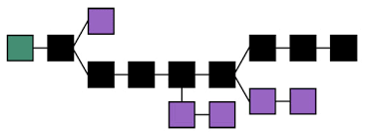
Proof of Work
The Great Firewall of China
The Chinese Bitcoin Blockchain will grow longer as ~71% of hashpower is in China.
The Bitcoin network always accepts the longest Blockchain/most computation power as the single state of truth.
If China re-opens their Blockchain to their world, their Blockchain will be longest, making the world accept the Chinese version of the truth.
Definition of a 51% attack!!
13

Slide 15
Proof of Work
Power Consumption
So Bitcoin has a lot of issues with centralisation due to ASICs, pooling, China and economies of scale.
Why hasn’t Bitcoin incurred a 51% attack ?
GAME THEORY and GOVERNANCE
How do we solve these issues with power expenditure?
We could focus more on building nuclear or hydro electric power to fuel the network.
Others believe that using Alternative Consensus Protocols can leverage the security of Bitcoin while removing the need to use power to mine ….
(we will get to this a little later….)
Bitcoin networks expected annual electricity expenditure is 73.12 TWh
More then Austria!
14

Slide 16



Alternative Consensus
Proof of Stake
Upon commencement of a Proof of Stake protocol, network participants receive a distribution of tokens via ICO, or through their holdings if the protocol is going from PoW to PoS.
They then “stake” their tokens in order to have a chance to be selected to write the next block.
If selected, they get to write the next block.
Called “forgers”
If there is a fixed amount of money, forgers only receive transaction fee, if there is a fixed money supply they receive reward + transaction fee.
15

Slide 17
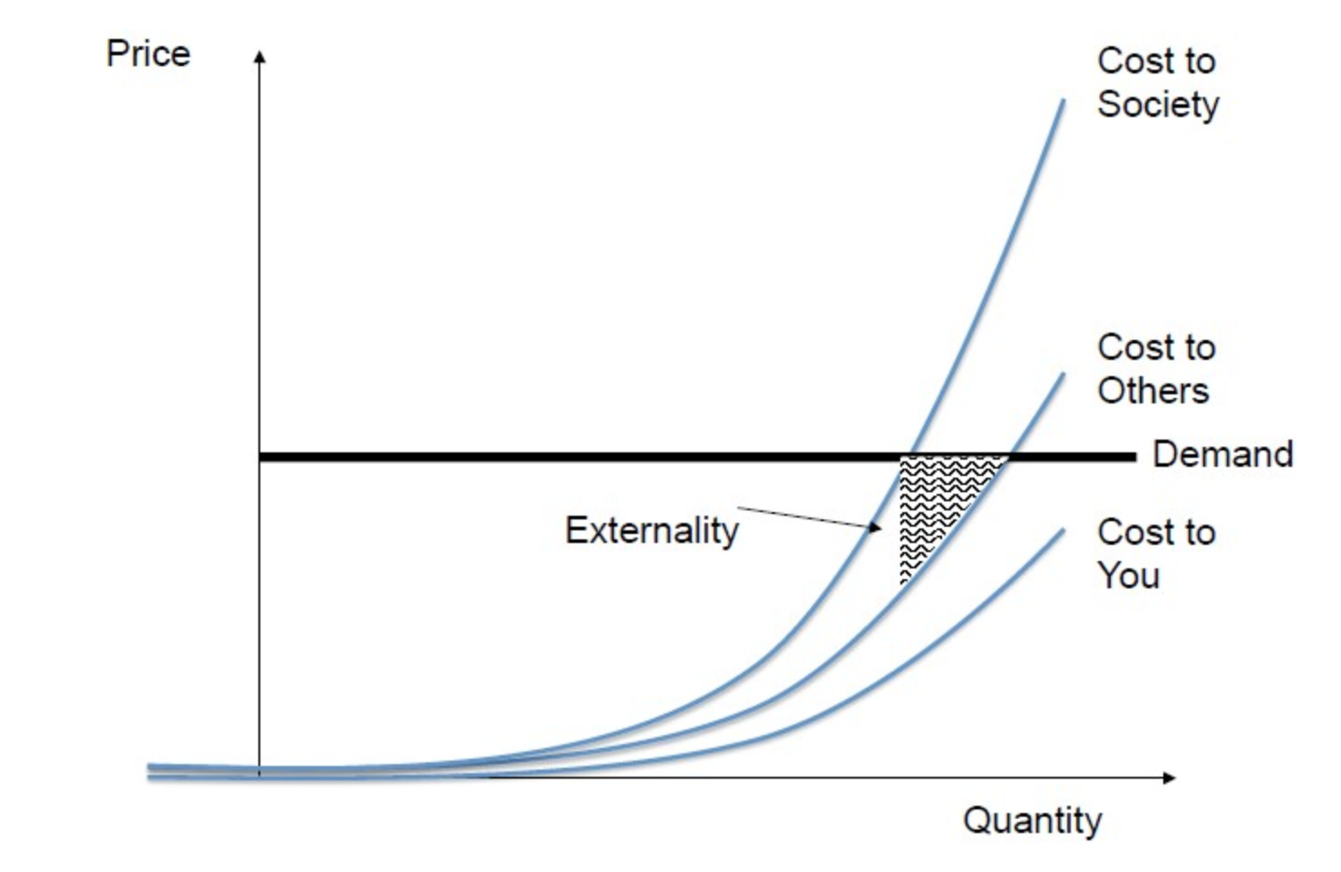
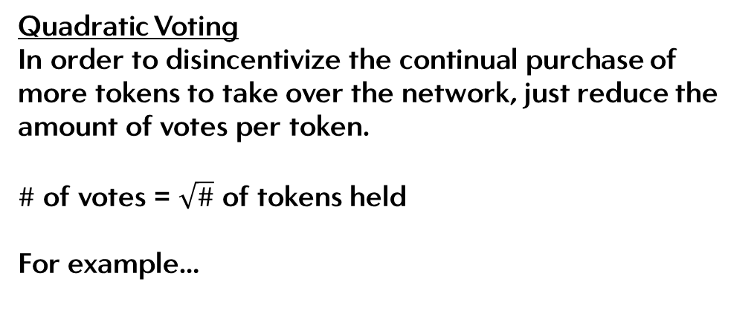
PROOF OF STAKE
Quadratic Voting
Quadratic Voting
In order to disincentivize the continual purchase of more tokens to take over the network, just reduce the amount of votes per token.
$\#$ of votes = $\sqrt{\#}$ of tokens held
For example…
1 token = 1 vote
4 token = 2 votes
9 token = 3 votes
…….
40000 token = 200 votes!
16

Slide 18
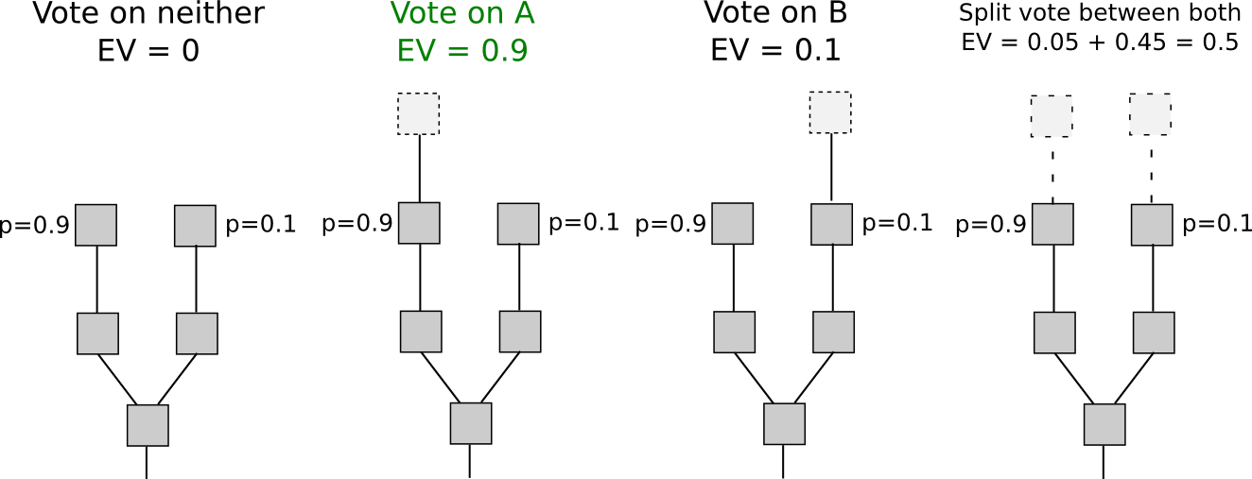
PROOF OF STAKE
Nothing-at-stake
The Nothing-at-stake problem is a unique issue in early Proof of Stake models, where initially just holding tokens provided voting rights.
In Proof of Work, miners expend real estate, power, infrastructure and hardware costs before they potentialy receive a reward. Realized costs
In Proof of Stake, forgers stake and act well in order to mitigate potential loss of economic value.
As there is no realized cost in Proof of Stake, a forger can mine every fork in order to ensure they forge on the right Blockchain
17

Slide 19
Governance
Primer
“Governance refers to all actions such as decision-making processes that are involved in creating, updating, and abandoning formal and informal rules of a system.”
Governance sits at the very centre of Blockchain technology.
The world currently has 1000’s of years of research in centralised governance protocols (governments, corporates etc), but for decentralised protocols, we are at the beginning of movement of fundamental research.
18

Slide 20
Bitcoin
Scripting
Scripting is intentionally kept simple. Bitcoin is only meant to send money!
Reverse Polish, Stack Based.
Not Turing complete
No loops.
WHY?
Removes potential attack vectors
Less potential ways to mix code that can create bugs
Harder to exploit for hackers
Removes un-necessary use of hashrate!
So what’s the problem? A simple language means simple transactions. What if we wanted to do more?
19

Slide 21


Bitcoin
Metadata
Metadata is arbitrary data that can be stored in a Bitcoin Blockchain using the OP_RETURN op-code.
Users have up-to 80 bytes worth of data (1 byte = 1 character) to spend.
Controversial in the Bitcoin community; the vision for Bitcoin was to store a record for transactions not to save information about stocks, bonds, IoU’s etc.
20

Slide 22


Bitcoin
Colour coin examples
Namecoin was an early implementation of secure digitized identity and Domain Name Service Data
A precursor to Ethereum before diverting paths, Mastercoin attempted to create custom digital assets (tokens) that were tradable just like the alt-coins of today.
21

Slide 23

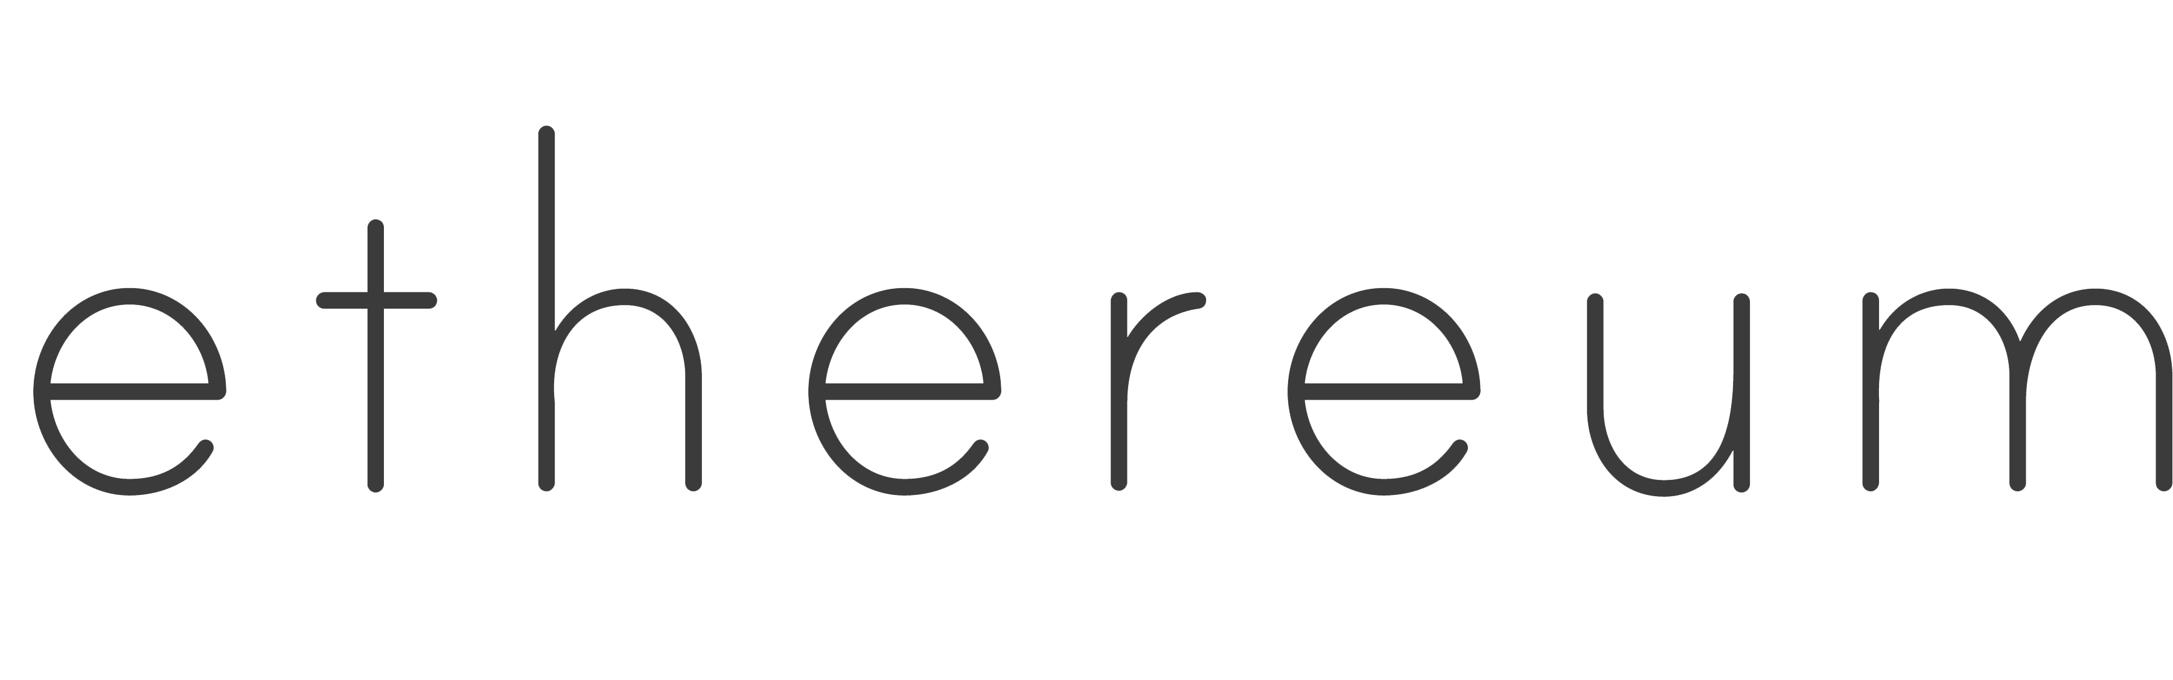
Ethereum
Conception
Raised 16 million USD 31st August 2014
1 btc = 2000 eth
But why Ethereum?
(nearly)-Turing complete language, solidity, allowed for complex “smart contracts” (high functionality transactions).
Đecentralised Applications that could be built using smart contracts.
No down time, censorship resistant etc
22

Slide 24
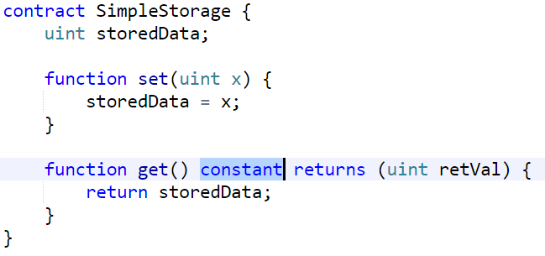
Ethereum
Solidity
Solidity is a statically-typed programming language.
Compiled down into byte code and run on the EVM.
Similar to JavaScript but geared towards Object Orientated Programming Languages (C++, C# etc).
Allows for much more complex transactions on the Blockchain.
23

Slide 25

Ethereum
The World Computer
Solution?
Casper and Plasma
The idea of the Ethereum Virtual Machine meant that at anytime you could execute smart contracts and
Decentralise applications.
Miners would be incentivized to process all data for your applications through mining fees!
Incredible! … but what’s the catch?
Deconomy April 2018
Ethereum is x1,000,000 most costly to store data and provide computational power.
It doesn’t scale and it is slow!
24

Slide 26
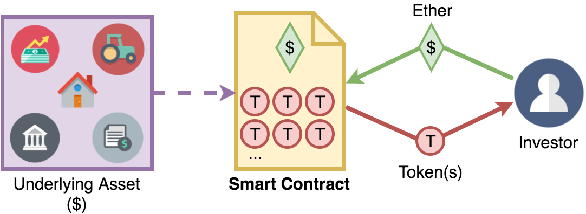
Ethereum
Smart Contracts
But what are “smart contracts”.
“A smart contract is a computer protocol intended to digitally facilitate, verify, or enforce the negotiation or performance of a contract”.
Instead of sending transactions, sender can create an arbitrary set of requirements for the receiver to meet.
25

Slide 27
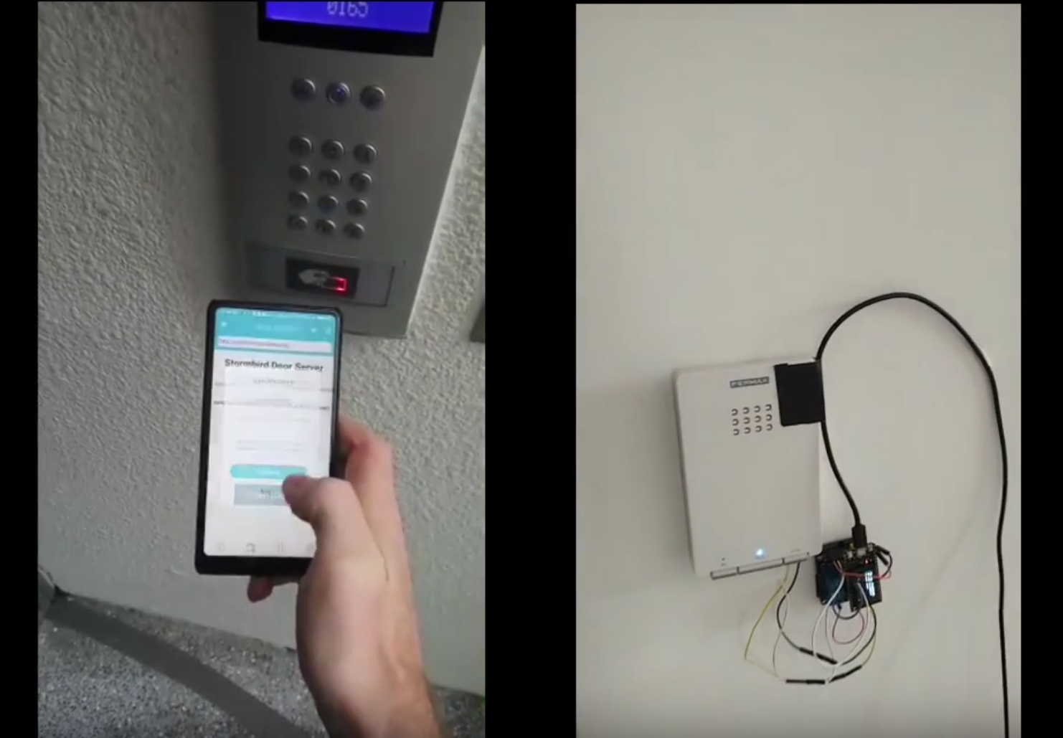
Ethereum
Smart Contracts (2)
Smart contracts have many, if not infinite applications.
Requirements for receiver are set in a high level language, so it’s easier to code smart contract requirements rather then using Script in Blockchain.
IoT
Interfacing a smart contract with a door
Payment upon entry, once confirmed on the Blockchain, is relayed to actuators that open a door for entry
https://www.youtube.com/watch?v=D_pMOMxXrYY&feature=youtu.be
26

Slide 28
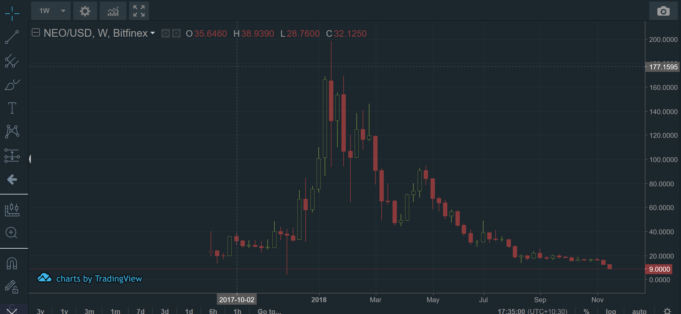
Ethereum
Smart Contracts (3)
ERC token standard
ERC 20 tokens. The go to token standard for raising funding via a Token Generation Event (TGE)
$7.3 Billion USD raised through ICO since conception.
27

Slide 29
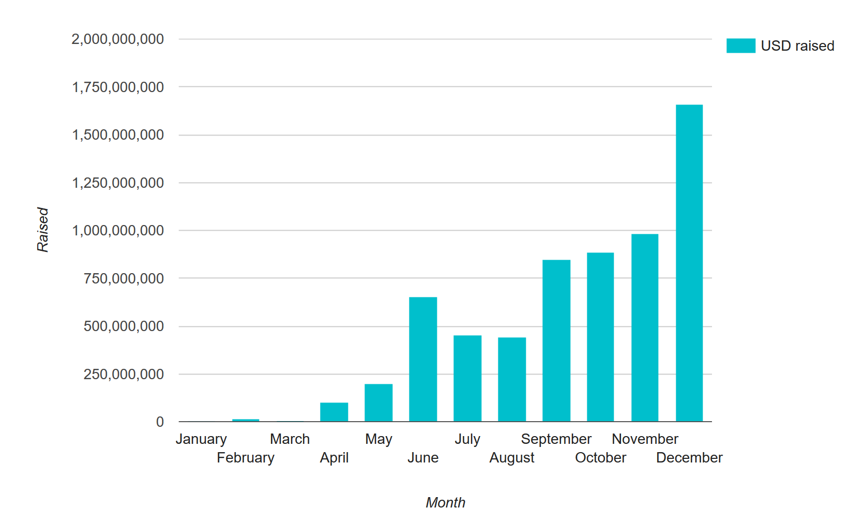
Ethereum
ERC20
28

Slide 30
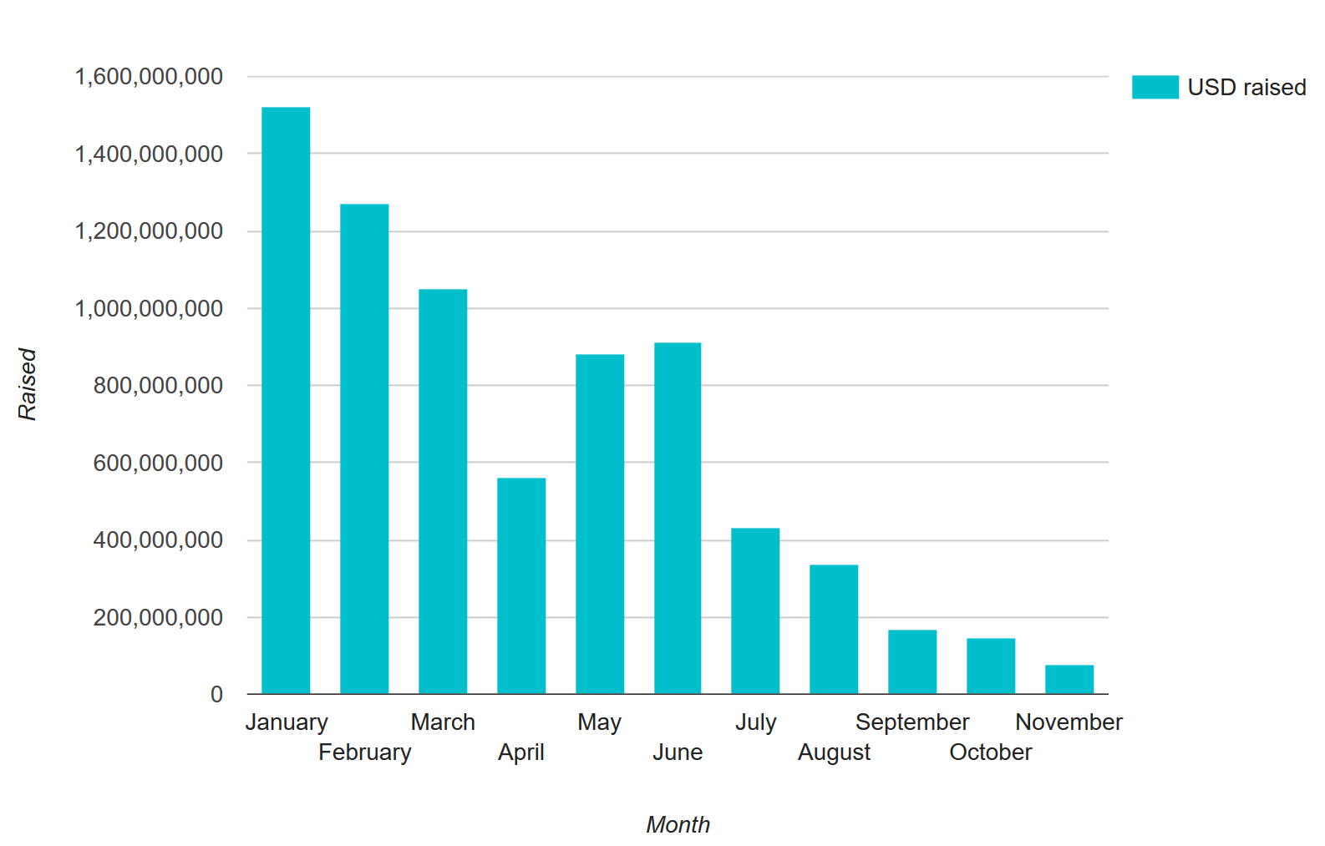
Ethereum
ERC20
29

Slide 31

Ethereum
Smart Contracts (3)
ERC token standard
ERC 20 tokens. The go to token standard for raising funding via a Token Generation Event (TGE)
$7.3 Billion USD raised through ICO since conception.
ERC 721: Non-Fungible-Tokens
Cryptokitties! Genesis, first cat, sold for 246.7 ETH (~$117,712 USD on the day)
ERC 725: Identity token standard
30

Slide 32
Blockchain primitives
Solidity Deep Dive
Workshop Examples
Building a token
2.

Slide 33
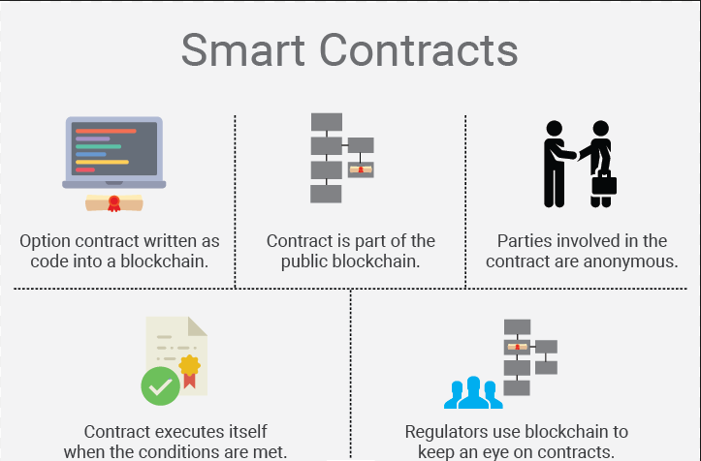
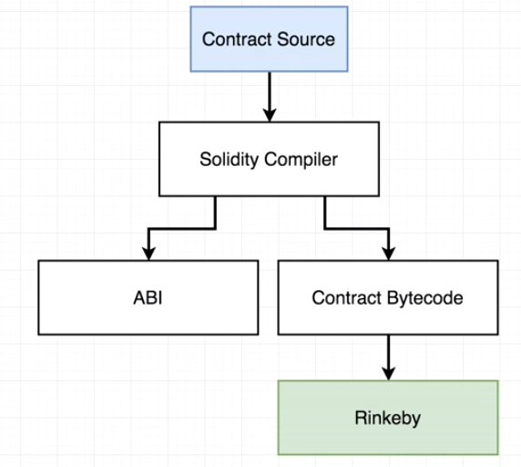
Solidity
In Depth
31

Slide 34
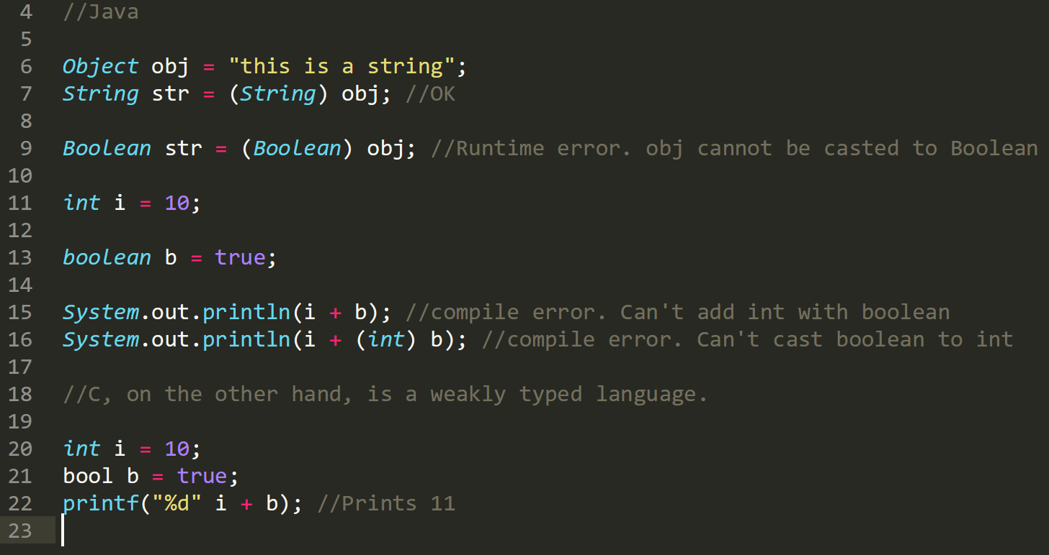
Solidity
In Depth
32

Slide 35
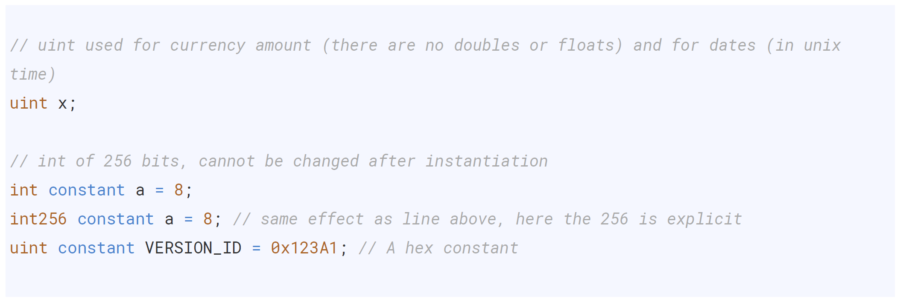
Solidity
In Depth
33

Slide 36
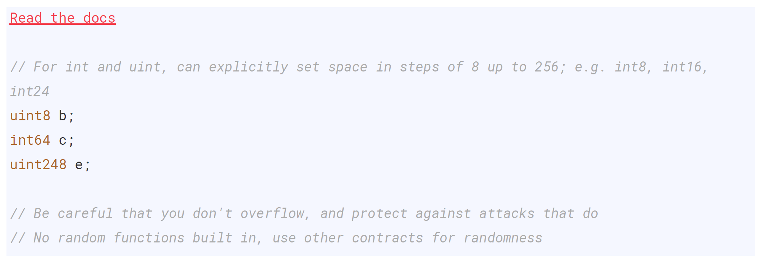
Solidity
In Depth
34

Slide 37
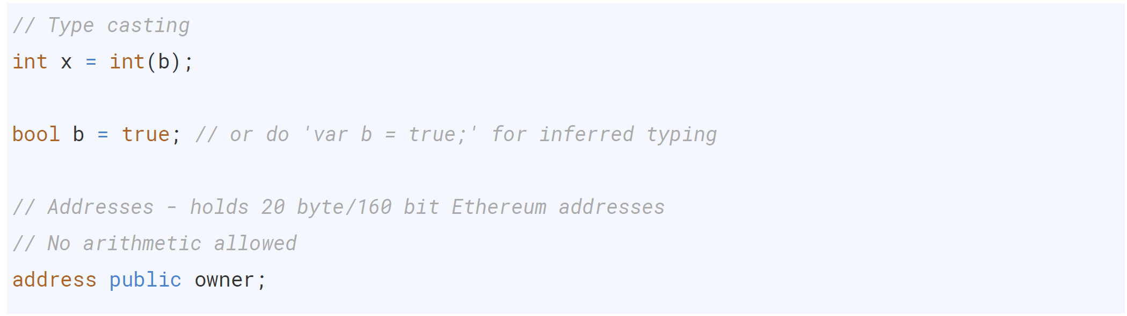
Solidity
In Depth
35

Slide 38
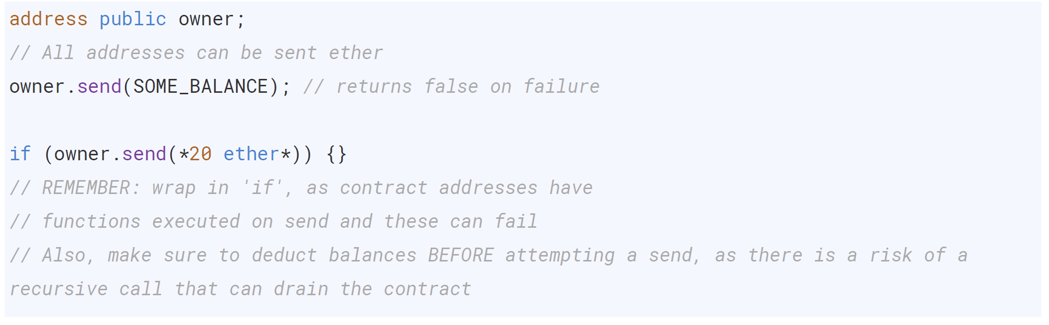
Solidity
In Depth
36

Slide 39
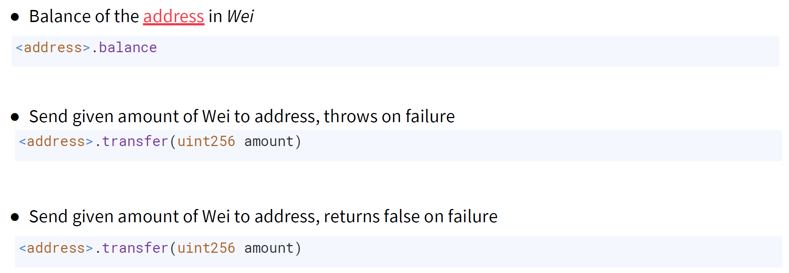
Solidity
In Depth
37

Slide 40
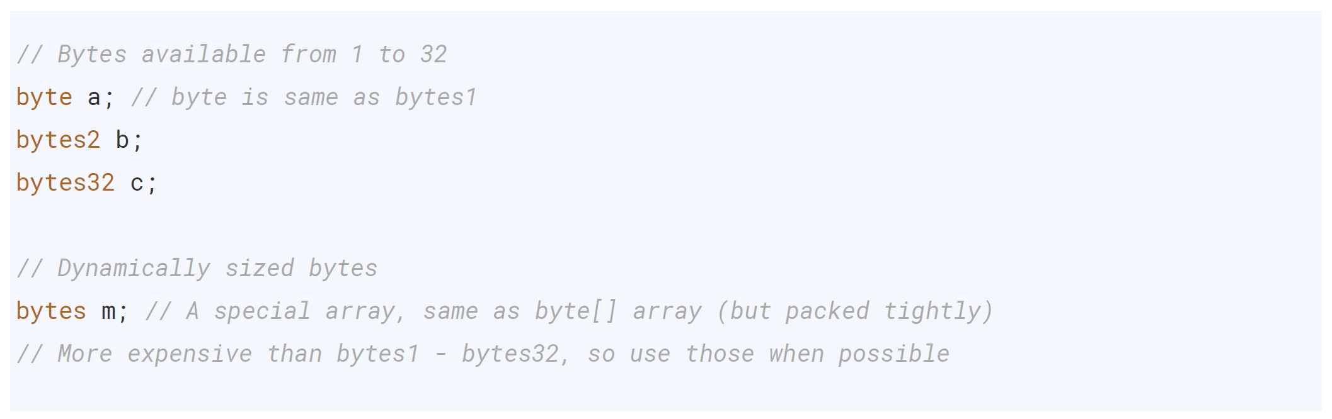
Solidity
In Depth
38

Slide 41
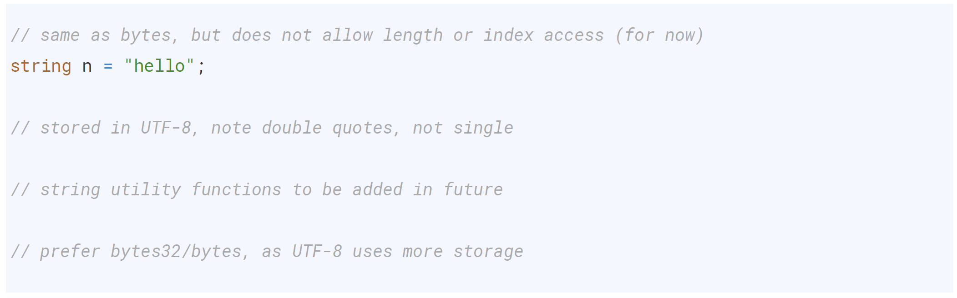
Solidity
In Depth
39

Slide 42
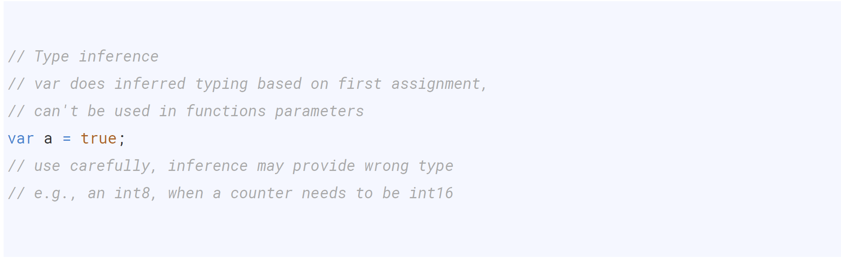
Solidity
In Depth
40

Slide 43
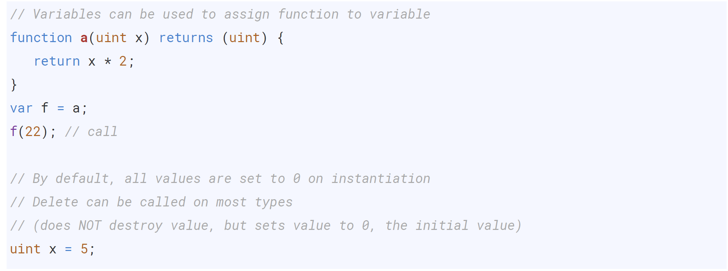
Solidity
In Depth
41

Slide 44
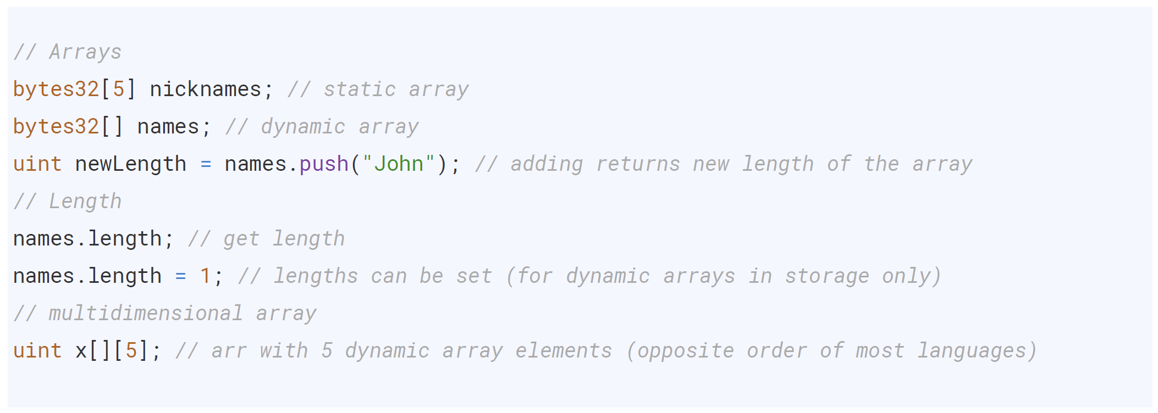
Solidity
Data Structures
42

Slide 45
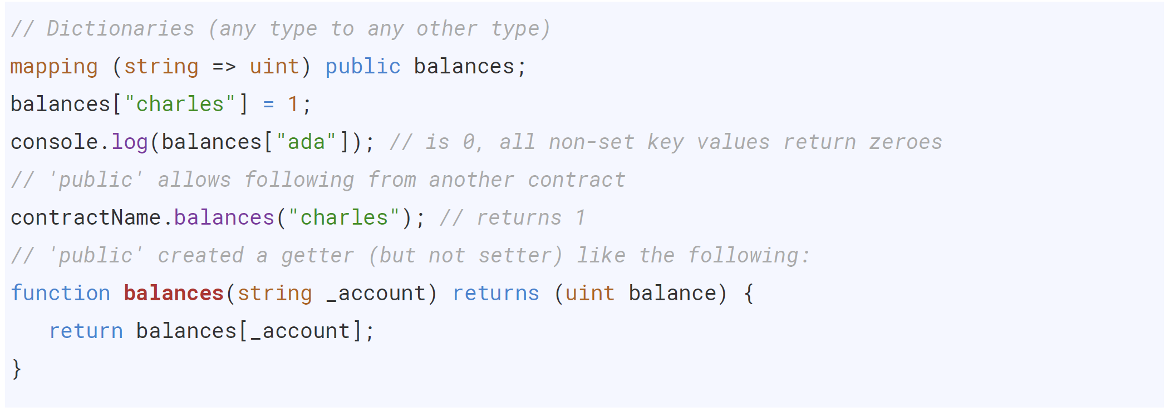
Solidity
Data Structures
43

Slide 46
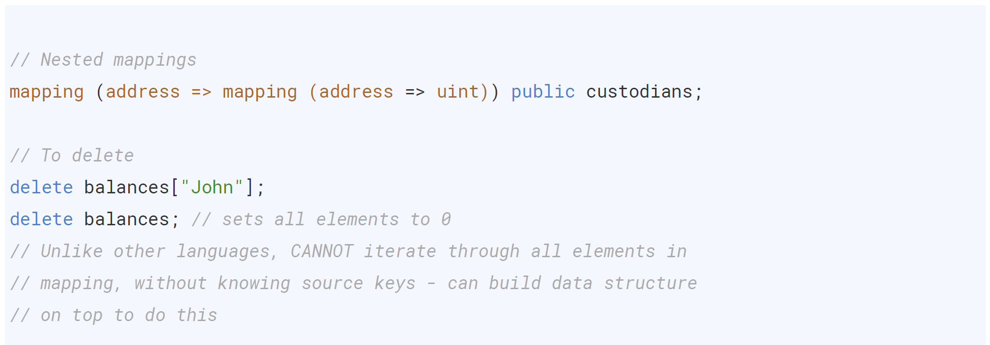
Solidity
Data Structures
44

Slide 47
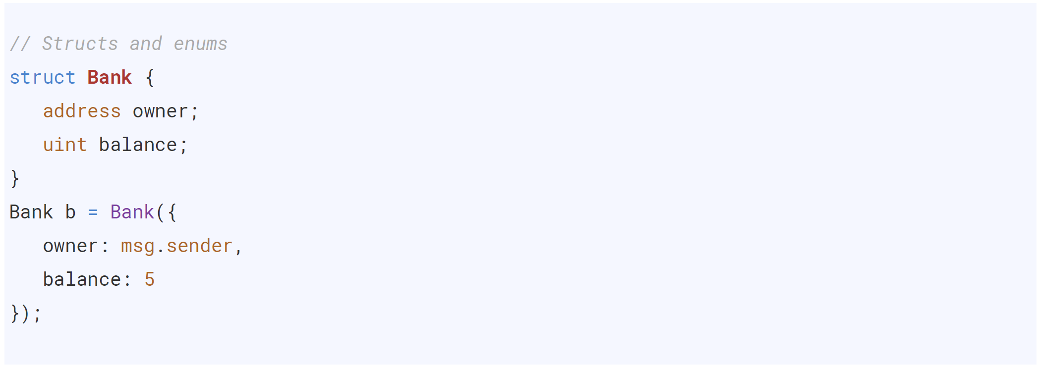
Solidity
Data Structures
45

Slide 48
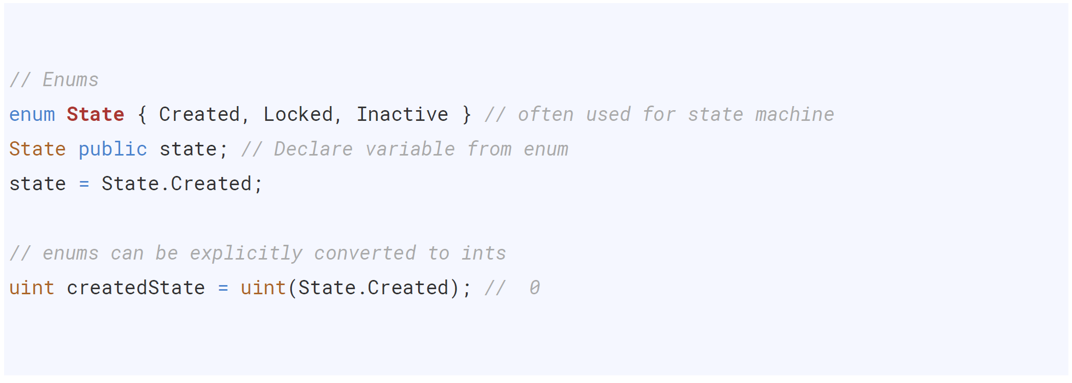
Solidity
Data Structures
46

Slide 49
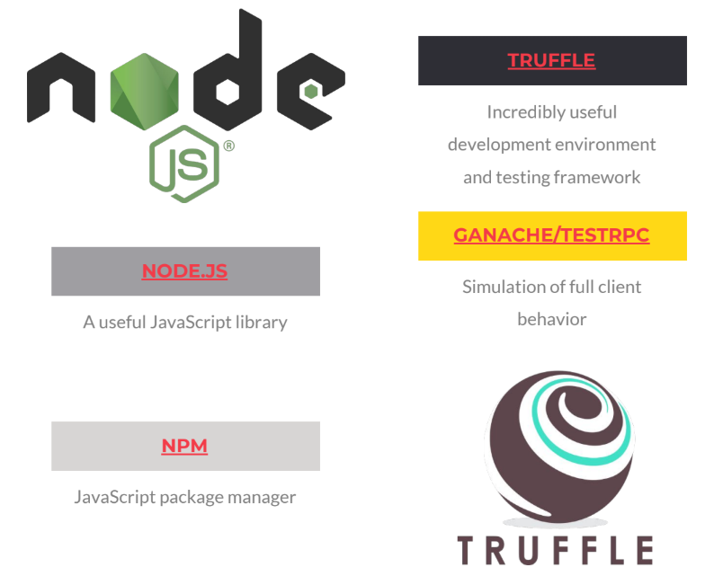
Ethereum
Tools
NodeJS and NPM
NodeJS is a server-side JavaScript platform to create apps that will help to communicate with your Ethereum node.
Truffle
Truffle is build framework used to compile, test and deploy your smart contract. It helps for faster development life cycle
48

Slide 50
Ethereum
Tools
Go-ethereum
Geth or go-ethereum is a command line interface, which allows you to run and operate ethereum node. Geth is implemented in Go. Allow for following functionalities:
To Mine blocks To generate ethers To create and manage accounts To deploy and interact with smart contracts To transfer funds To inspect block history To connect to the public ethereum network (mainnet) or to create your own private network
49

Slide 51
Ethereum
Remix IDE
REMIX IDE
https://remix.ethereum.org
50

Slide 52
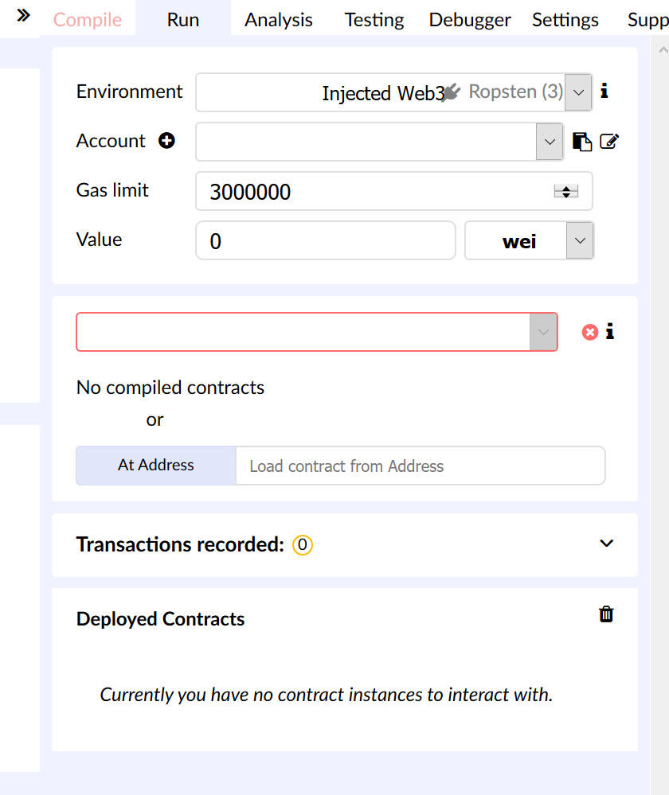
Ethereum
Remix IDE
Environment: ’pseudo’ ethereum
Gas Limit: Maximum gas allocated
Value: used to make a tx, and send along some amount of ether with that tx
Inbox: Selecting a contract we want to deploy to our local test network that is running inside of the browser
String || Create: Constructor function. Instance of ‘Inbox’ created; constructor uses what string as input to initialise.
51

Slide 53
Ethereum
Remix IDE
EXAMPLE 1
51

Slide 54
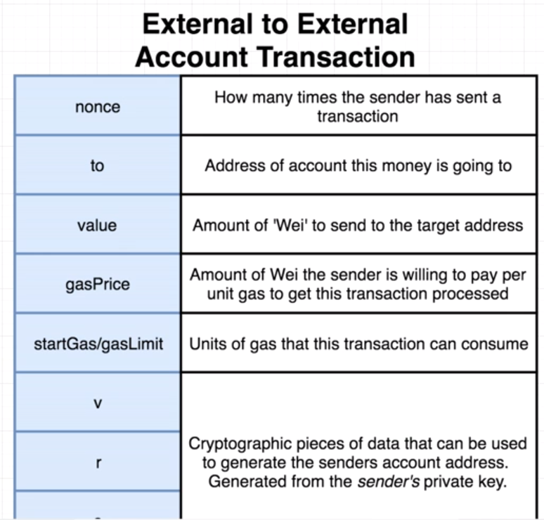
Ethereum
Behind Deployment
Transaction information -
Creation of a smart contract is quite similar to the transaction of money between two parties.
The main difference of the two is what is placed in the to section of the transaction.
52

Slide 55
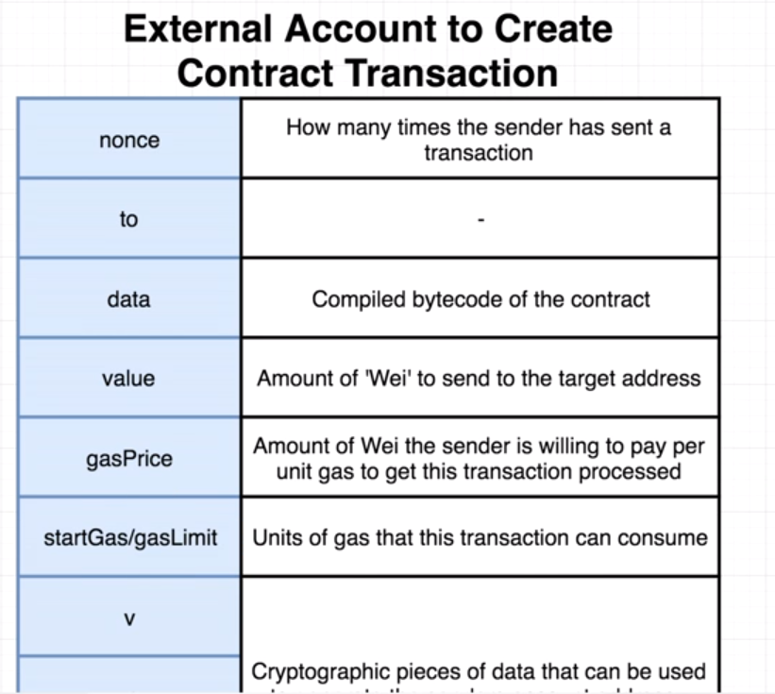
Ethereum
Behind Deployment
Leaving the to section blank tells the network that the sender will attempt to establish a contract.
Data Field
Byte code for contract
Value Field
Initial amount of wei assigned to the contract
52

Slide 56
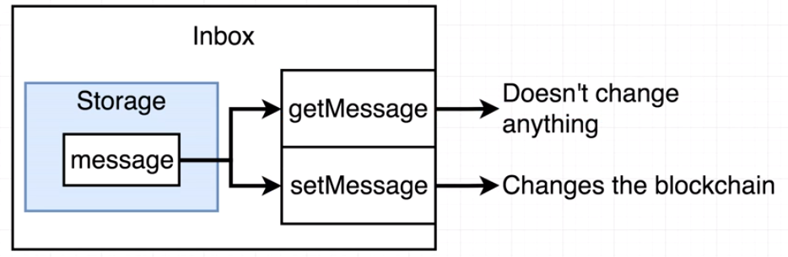
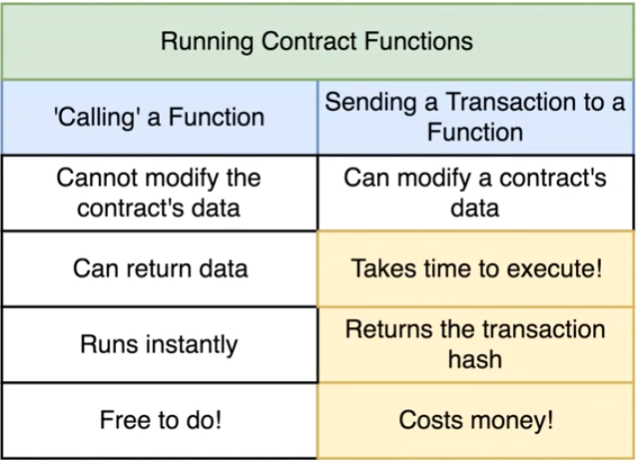
Ethereum
Behind Deployment
Anytime we wish to change the data attributed (using a “setter”) we need to conduct another transaction (data change has to be verified by miners!)
54

Slide 57
Ethereum
Behind Deployment
EXAMPLE 2 - GAS
54

Slide 58
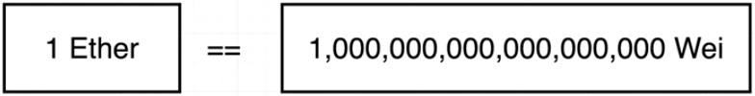
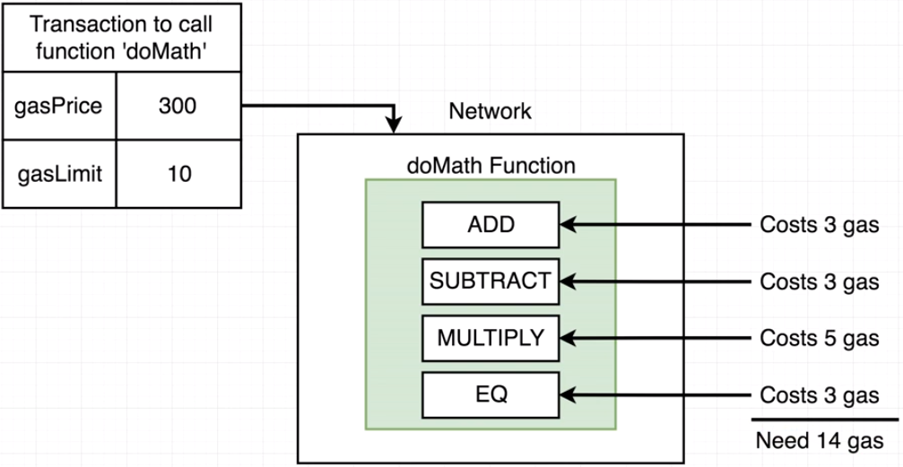
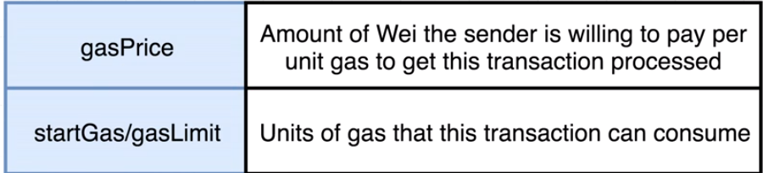
Ethereum
Behind Deployment
Gas Field
Whoever creates the transaction has to supply the gas!
Github Table
55

Slide 59
Ethereum
Behind Deployment
EXAMPLE 2.5 – Hello World

Slide 60
Ethereum
Behind Deployment
Your turn!
Please give your best take on the tasks below!
1) Design a greeter similar to the one we just did! Add creativity to it and then show it to the others!
2) Design a code (iteration/recursion) for the Fibonacci sequence F(n) = F(n)-1 + F(n)-2
55

Slide 61
Ethereum
Metamask
We will be using Metamask today to interface wallet functionality with Remix! Download it!
https://Metamask.io
56

Slide 62
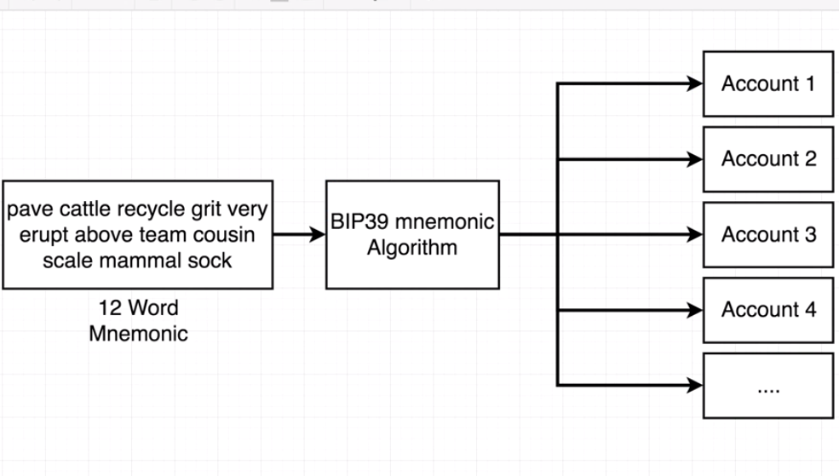
Ethereum
Metamask
Mnemonic Primer - Metamask
Metamask simplifies private key creation and retrieval by using a 12 word string
57

Slide 63
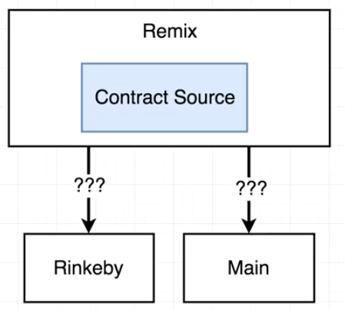
Ethereum
Testnets
Ropsten
https://faucet.metamask.io/
Rinkebey
https://faucet.rinkeby.io/
58

Slide 64
Election Ballot!
4.

Slide 65
Building a token
4.

